Slide 1

Storage and files
Lesson 13

Slide 2
What the Lesson Will Cover
Know how to create, open and write to a file
Display and read the contents of the file
Know how to list the names of the files stored on the micro:bit

Slide 3
Files
.txt – Text
.doc or .docx – MS Word
.xls or .xlsx – Excel
.jpeg – Images
.NES – Nintendo (NES) ROM File
Notes:
Start with the file extension quiz.

Slide 4
Storage
Storage refers to a location where you can hold data
When the device is turned off or reset, the data is still held and available each time the device is started up back up.
Most computers have a hard disk which is used as the storage –often referred to as secondary storage.
The micro:bit has approximately 30k of storage
This is enough to store 30,000 letters, symbols or numbers
You can create, write and read files using Python code

Slide 5
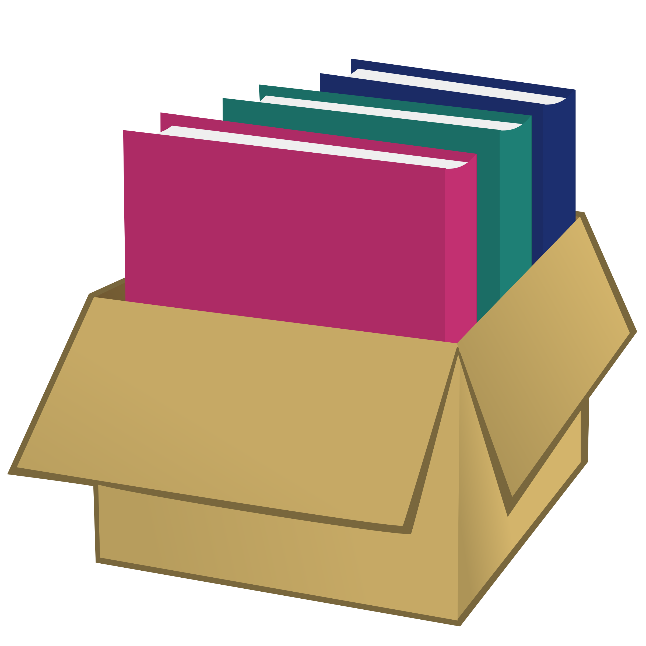
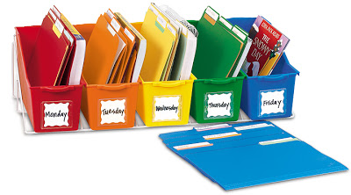
Flat-file and Directories
This Photo by Unknown Author is licensed under CC BY-ND
A directory system is like using different boxes to store different types of file
A flat-file storage system is like a single box to store everything
Notes:
Explain that the micro:bit uses a flat file system, similar to one box to hold everything. Other devices use directories, different boxes for different types of files.

Slide 6
Creating Files
Flashing your micro:bit will DESTROY ALL YOUR DATA since it re-writes all the flash memory used by the device and the file system is stored in the flash memory.
However, if you switch off your device the data will remain intact until you either delete it or re-flash the device.
Notes:
Warning, share with students

